Slide 1
Malvern Primary School
Welcome
Nursery Class – September, 2020

Slide 2
The staff of Malvern welcome your family to our family…
Head Teacher Mr T James
Assistant Head Teacher Mr P Kynaston
Lead Teacher Mrs N McGorian
Early Years Governor Mr M Johnson
Early Years Lead Miss R Hilliard
SENCO Mrs S Horan
Learning Mentor Miss S Baker
Nursery Teacher Mrs Horan
Reception Teachers Miss R Hilliard / Mrs Z Woodward
Early Years Specialist Mrs C Gaughan
Early Years Practitioners Mrs S Mullins, Mrs D Reid, Miss S Joughin and Miss L Bullen

Slide 3
Returning to Malvern Primary School
Stay and Play Event
On Friday 11th September we will be holding our Early Years Foundation Stage (EYFS) ‘Stay and Play’ event. This event is for children and parents to visit and play with retuning and new class friends. We have two experienced EYFS practitioners joining our team this year. Mrs Horan will be our new nursery teacher and Mrs Gaughan will also be joining the team. There are two options for this meeting. Please attend the session that is more convenient:
9.15am - 11.15am or 1.15pm - 3.15pm

Slide 4
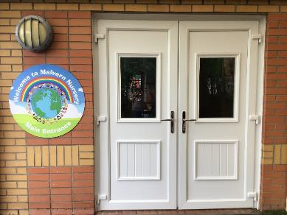
Coming in to school
Returning Families
To encourage smooth transition, we stagger intake from week commencing Monday 14th September 2020. This provides time for our team offer support on an individual level.
All returning nursery children will start school on Monday 14th September 2020.
AM Session 8.30am – 11.30am
or
PM session 12.30am – 3.30pm
Notes:
Please note that our nursery times have slightly changed. For your convenience our nursery now finishes at the same time as the rest of the school.

Slide 5
Transitioning to Malvern Primary School
New Starters
Home Visits
In order to support transition, our nursery teacher, Mrs Horan, will telephone each family later this week. To arrange a mutually convenient time for a home visit.
Home visits will take place on; the 4th, 7th, 8th 9th and 10th September.
Stay and Play
On Friday 11th September, we will hold our Early Years Foundation Stage ‘Stay and Play’ event. This event is for children and parents to visit and begin to build connections between home and school. We value the relationship between home and school immensely and we look forward to welcoming you into our community.
9.15am – 11.15am or 1.15pm -3.15pm
Notes:
We eagerly await meeting our newest pupils and look forward to children joining us in September.

Slide 6
Coming into school
New Starters
To encourage smooth transition, we stagger intake from the week commencing Monday 21st September 2020. This provides time for our team to get to know each child on an individual level and offer support where necessary. Mrs Horan will provide you with more details about your child’s individual start date at our stay and play event.
Wrap around care is available with KIB for further information please contact via Telephone - 0151 477 8236
or
Email - mark-kidsinbloom@hotmail.com
Notes:
Mornings can be a very busy time for us, some children need support transitioning into school from home and this is entirely normal. Once all the children have left our care in the evening, you may wish to have a face to face conversation. We are aware some parents/carers work long hours and we would encourage you to ring school to arrange a mutually convenient time should you need to talk with us.

Slide 7
The Cloakroom
We encourage you to bring your child into Nursery on their first day, hang their coat up with them and give them a big squeeze before leaving.
Our cloakroom can become a bit of a squeeze with several adults and children in it. Therefore, we politely ask that once your child is familiar with the setting you hand them over to us at the entrance door.
Children will be able to store their books bags and PE kits. Unfortunately, due to space we are unable to accommodate any other bags. To avoid any upset please be mindful of this when purchasing school bags.
Notes:
Transition times can be a very busy for us, some children need support transitioning into school from home and this is entirely normal. Once all the children have left our care in the evening, you may wish to have a face to face conversation. We are aware some parents/carers work long hours and we would encourage you to ring school to arrange a mutually convenient time should you need to talk with us.

Slide 8
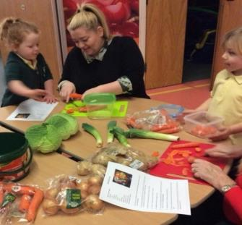
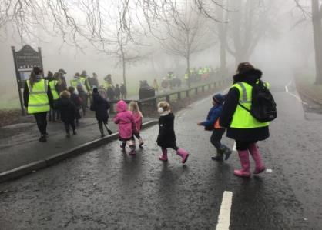
Parental Involvement
“I can peel cabbage with mummy, I am doing good.”
“I went on a Bear Hunt with my Nan! The mud was the best”
Notes:
Here, at Malvern, working with families and the community is at the heart of all that we do. In the EYFS we host ‘Stay & Play’ - you will be invited in to school, to work collaboratively to build on and extend your child’s learning through play. At various points within the year we have parent workshops. These workshops will offer you advice and tips on how to support your child’s learning at home. As such, these sessions really are invaluable. If parents are unable to attend, we welcome other family members to join us wherever practicable. You will find that during your time with us in EYFS, children venture around the local community and beyond. We value parental support and actively encourage parents to come with us. Malvern is at the heart of the community, our exciting local functions, ‘Autumn Festival’ and ‘Summer Carnival’ are a celebration of our local community and we hope you will join us at these events. The dates of all key events are listed in your child’s planner and school website.

Slide 9
Exciting Events
Autumn…
Tapestry Meeting McMillian Event Book Fair EYFS Workshop Reading Workshop Malvern Autumn Festival ‘Nocturnal Animals’ Parent / Teacher Meeting Stay and Play PTA Christmas Event Christmas Performance Celebration Assembly
Spring…
Nursery Library Open Day World Book Day ‘Are You Ready to Read?’ Book Fair Parent / Teacher Meeting PTA Easter Bingo Reading Workshop Celebration Assembly
Summer…
Stay and Play Teddy Bear’s Picnic EYFS Workshop Transition Meetings Maths Workshop Sports Day Trip to Chester Zoo Malvern Summer Carnival

Slide 10
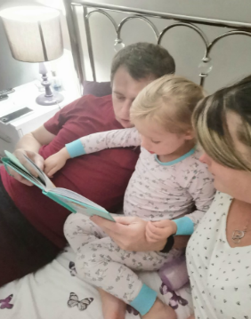
Home Learning
Parents and children will be asked to engage in a ‘Home Learning’ practical activity. The task will be consolidation of recent learning. We will post the ‘Home Learning’ task on Tapestry for you and your child to enjoy. We will host a Tapestry meeting to explain how to use the platform
Wednesday 30th September 2020
9.00am or 5.00pm
Children will also bring home a book to share with you. We will be hosting a parent reading workshop in October, this will give you ideas on how best to support your child’s early reading at home.
Wednesday 21st October 2020
10.45am or 3.40pm
Notes:
The workshop is invaluable to your child’s development in reading. We understand many of our parents have working and other commitments at various times of the day. To accommodate this, we facilitate workshops at different times wherever possible. If parents are unable to attend, we would welcome another family member to join us.

Slide 11
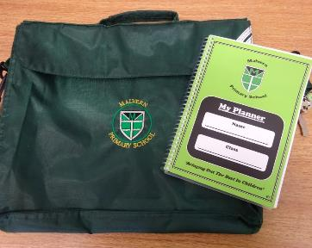
Book Bag and Planners
Your child's book bag is a very important piece of kit. It will contain your child’s planner, reading book, and any letters which are sent home.
We check your child’s planner each day and we politely request you do the same. Please record each reading session in the planner.
There is a lot of useful information in the planner. Such as dates of our; community events, school trips, parent workshops and term dates. There is also guidance to support your child’s learning and development at home.

Slide 12
Getting your child ‘school ready’
Teach your child to use the toilet independently.
Allow children the opportunity to build their muscles in their mouth. Having a dummy can hinder this development and your child may find it difficult to communicate with other children. This can be very frustrating for children.
Show your child their school items and explain that these belong to them. Other children will have the same jumper, so it’s important they start to understand how it’s personally labelled; their name or a symbol.
Model to your child how to blow/wipe their nose.
Grow their independence by practising putting on their new school uniform, coat and school shoes.
We all have accidents from time to time. It really helps us, to support your child, if your child can communicate to us where it is that they have hurt themselves. Teaching your child the song ‘Head, Shoulders, Knees and Toes’ can aid their ability to communicate.
Notes:
We encourage all children to be ‘school ready’ when they enrol at Malvern. Being ‘school ready’ develops children’s self-esteem, self-belief and self- confidence. The more children can do independently, the more they will believe they can achieve. Belief is the key to success and we encourage all children’s achievements to be celebrated

Slide 13
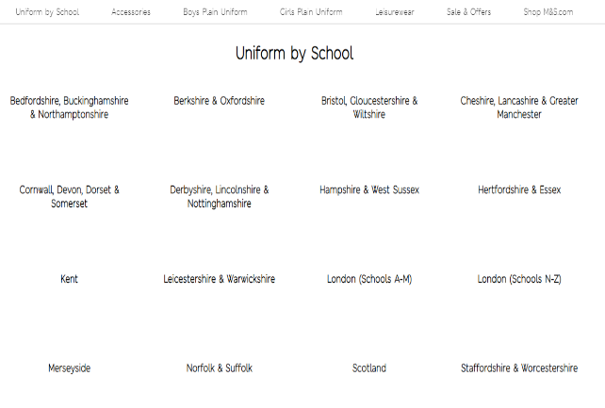
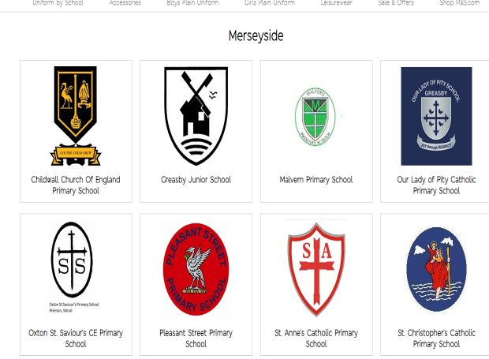
Uniform
https://www.mandsyourschooluniform.com/
Notes:
Uniform can be purchased online from Marks and Spencer. We ask that children wear…
https://www.mandsyourschooluniform.com/
The information is in your Parent Guide.
25% of all uniform from M&S

Slide 14
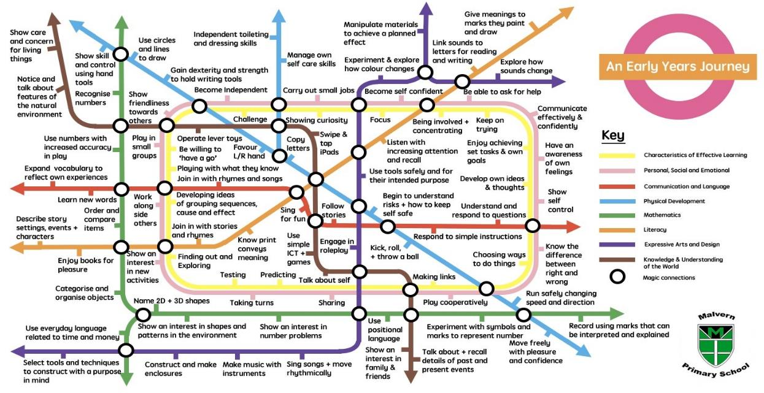
Life at Malvern…
Notes:
During the session children can explore both indoor and outdoors. Our caring, professional team provide exciting activities that foster children’s independence, resilience, self-esteem, self-belief and self- confidence. Our planning provides a range of experiences for children to accelerate within the prime areas. The prime areas are important because they lay the foundations for children’s success in all other areas of learning and of life:
Personal, Social and Emotional Development Physical Development Communication and Language
Our rigorous reading and mathematics programme RWI and Power Maths supports the development of children’s early reading, writing and mathematical skills.

Slide 15
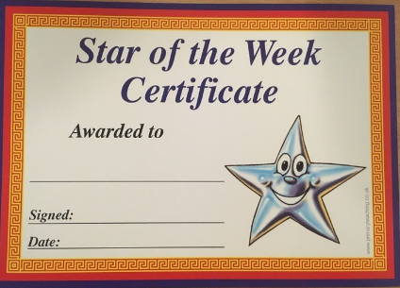
Life at Malvern…
On Friday a child from each class is chosen to be Star of the Week. They take home the class teddy until the following Thursday and can record all the fun they do together. This is awarded to the child who has been just that…. A Star.

Slide 16
Life at Malvern…
Children can come to school in their own clothes on their birthday.
We ask that children do not bring their own water bottles. We encourage children to regularly hydrate at our water station. Additionally, your child may wish to have a drink of milk. We provide fruit and snack. We ask for a voluntary contribution of £5.00 each half term.
We go outside in all weathers! Children will need a pair of wellingtons with their name on to keep in school. We would also advise that children bring a warm coat with them each day. Wet suits are provided by the school.

Slide 17
Life at Malvern…
We understand that these are unique times for us all.
We really do value the relationships with all our parents at Malvern and will be as transparent as we can.
Please feel free to ask us any questions.

