Slide 1
Malvern Primary School
Welcome
Reception Class – September, 2020

Slide 2
The staff of Malvern welcome your family to our family…
Head Teacher Mr T James
Assistant Head Teacher Mr P Kynaston
Lead Teacher Mrs N McGorian
Early Years Governor Mr M Johnson
Early Years Lead Miss R Hilliard
SENCO Mrs S Horan
Learning Mentor Miss S Baker
Nursery Teacher Mrs Horan
Reception Teachers Miss R Hilliard / Mrs Z Woodward
Early Years Specialist Mrs C Gaughan
Early Years Practitioners Mrs S Mullins, Mrs D Reid, Miss S Joughin and Miss L Bullen

Slide 3
Transitioning to Malvern Primary School
Group A
Monday 7th September – Thursday 10th September 8.30am – 11.15am
Please enter school via the main entrance. You will be able to take your child to class where you will be met by a member of the EYFS team. Once your child is in class, we ask that you leave them to play and then collect them via the main entrance again at 11.15am.
Wrap around care is available with KIB for further information please contact via Telephone - 0151 477 8236
or
Email - mark-kidsinbloom@hotmail.com
Friday 11th September 2020 ‘Stay and Play’ This event is for children and parents to visit and play with friends and team members. During this session, parents will be provided with information about class teachers for the forthcoming academic year.
9.15-11.15am or 1.15 – 3.15pm

Slide 4
Transitioning to Malvern Primary School
Group B
Monday 7th September – Thursday 10th September 12.30pm – 3.15pm
Please enter school via the main entrance. You will be able to take your child to class where you will be met by a member of the EYFS team. Once your child is in class, we ask that you leave them to play and then collect them via the main entrance again at 3.15pm.
Wrap around care is available with KIB for further information please contact via Telephone - 0151 477 8236
or
Email - mark-kidsinbloom@hotmail.com
Friday 11th September 2020 ‘Stay and Play’ This event is for children and parents to visit and play with friends and team members. During this session, parents will be provided with information about class teachers for the forthcoming academic year.
9.15-11.15am or 1.15 – 3.15pm

Slide 5
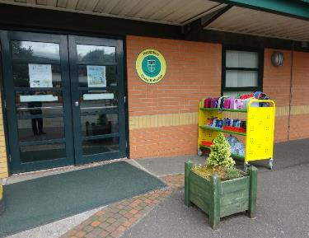
Coming into school
Monday 14th September – Wednesday 16th September
Children will start school at 8:45am and will finish at 1.00pm. The entrance to reception is on the court yard. There will be a member of staff at the door at the beginning of the day.
On these three days children will need to be collected from the office.
Children will start full time on Thursday 17th September at 8:45am and finish school at our usual time: 3:30pm.
Notes:
Mornings can be a very busy time for us, some children need support transitioning into school from home and this is entirely normal. Once all the children have left our care in the evening, you may wish to have a face to face conversation. We are aware some parents/carers work long hours and we would encourage you to ring school to arrange a mutually convenient time should you need to talk with us.

Slide 6
Coming into school
Lunch boxes and water bottles should be put on the trolley as your child comes into school each day, and collected each afternoon at home time. Clothing items without names are put on the bottom shelf of the trolley and will be moved to lost property at the end of each week.

Slide 7
The Cloakroom
We encourage independence from day one. Your child will have a peg for their coat.
In the morning, when you have left them at the entrance door, a member of staff will monitor the children in order to help anyone stuck with zips.
Children will be able to store their books bags and PE kits. Unfortunately, due to space we are unable to accommodate any other bags. To avoid any upset please be mindful of this when purchasing school bags.

Slide 8
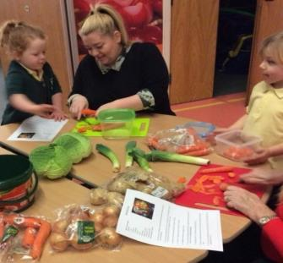
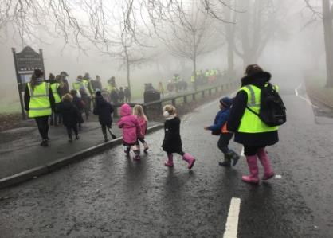
Parental Involvement
“I can peel cabbage with mummy, I am doing good.”
“I went on a Bear Hunt with my Nan! The mud was the best”
Notes:
Here, at Malvern, working with families and the community is at the heart of all that we do. In the EYFS we host ‘Stay & Play’ - you will be invited in to school, to work collaboratively to build on and extend your child’s learning through play. At various points within the year we have parent workshops. These workshops will offer you advice and tips on how to support your child’s learning at home. As such, these sessions really are invaluable. If parents are unable to attend, we welcome other family members to join us wherever practicable. You will find that during your time with us in EYFS, children venture around the local community and beyond. We value parental support and actively encourage parents to come with us. Malvern is at the heart of the community, our exciting local functions, ‘Autumn Festival’ and ‘Summer Carnival’ are a celebration of our local community and we hope you will join us at these events. The dates of all key events are listed in your child’s planner and school website.

Slide 9
Exciting Events
Autumn…
Tapestry Meeting McMillian Event Book Fair EYFS Workshop RWI Workshop Malvern Autumn Festival ‘Nocturnal Animals’ Parent / Teacher Meeting Stay and Play PTA Christmas Event Christmas Performance Celebration Assembly
Spring…
Library Open Afternoon Trip to Court Hey World Book Day ‘Are You Ready to Read?’ Book Fair Parent / Teacher Meeting Trip to ASDA Huyton Cooking Class PTA Easter Bingo RWI Meeting Celebration Assembly
Summer…
Stay and Play Trip to Delamere Forest EYFS Workshop Transition Meetings Maths Workshop Sports Day Trip to Windmill Farm Malvern Summer Carnival Summer Disco

Slide 10
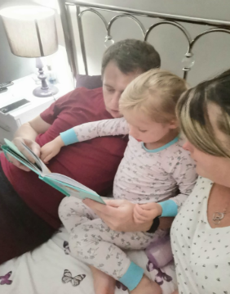
Home Learning
Parents and children will be asked to engage in a ‘Home Learning’ practical activity. The task will be consolidation of recent learning. We will post the ‘Home Learning’ task on Tapestry for you and your child to enjoy. We will host a Tapestry meeting to explain how to use the platform
Wednesday 30th September 2020 9.00am or 5.00pm
Children will also bring home a book to read to you and a library book to share with you. There will be a workshop in October to explain further the reading programme we use.
Wednesday 21st October 2020 9.00am or 5.00pm
Notes:
The workshop is invaluable to your child’s development in reading. We understand many of our parents have working and other commitments at various times of the day. To accommodate this, we facilitate workshops at different times wherever possible. If parents are unable to attend, we would welcome another family member to join us.

Slide 11
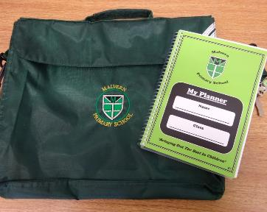
Book Bag and Planners
Your child's book bag is a very important piece of kit. It will contain your child’s planner, reading book, and any letters which are sent home.
We check your child’s planner each day and we politely request you do the same. Please record each reading session in the planner.
There is a lot of useful information in the planner. Such as dates of our; community events, school trips, parent workshops and term dates. There is also guidance to support your child’s learning and development at home.

Slide 12
Getting your child ‘school ready’
Teach your child to use the toilet independently.
Allow children the opportunity to build their muscles in their mouth. Having a dummy can hinder this development and your child may find it difficult to communicate with other children. This can be very frustrating for children.
Show your child their school items and explain that these belong to them. Other children will have the same jumper, so it’s important they start to understand how it’s personally labelled; their name or a symbol.
Model to your child how to blow/wipe their nose.
Grow their independence by practising putting on their new school uniform, coat and school shoes.
We all have accidents from time to time. It really helps us, to support your child, if your child can communicate to us where it is that they have hurt themselves. Teaching your child the song ‘Head, Shoulders, Knees and Toes’ can aid their ability to communicate.
Notes:
We encourage all children to be ‘school ready’ when they enrol at Malvern. Being ‘school ready’ develops children’s self-esteem, self-belief and self- confidence. The more children can do independently, the more they will believe they can achieve. Belief is the key to success and we encourage all children’s achievements to be celebrated

Slide 13
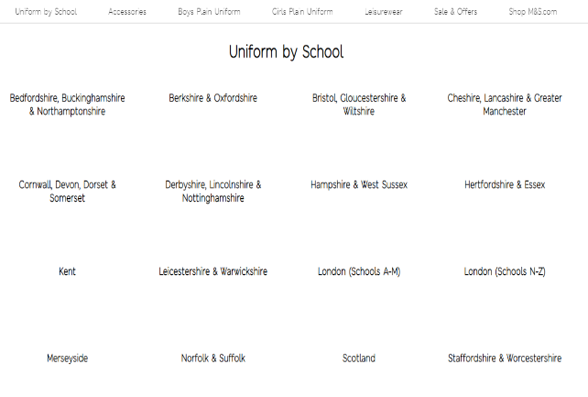
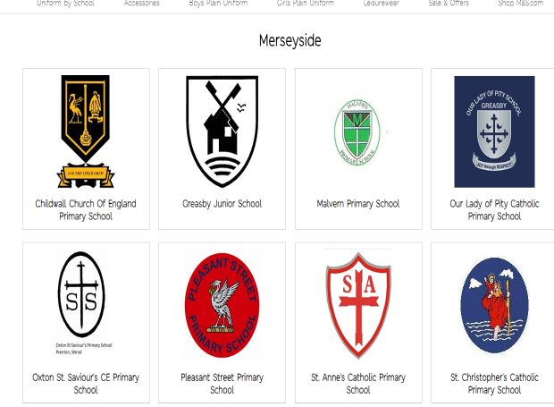
Uniform
https://www.mandsyourschooluniform.com/
Notes:
Uniform can be purchased online from Marks and Spencer. We ask that all children wear…
https://www.mandsyourschooluniform.com/
The information is in your Parent Guide.
25% of all uniform from M&S

Slide 14
Lunch Time
Lunchtime is 11.45am. Reception children will be taken in to the hall by the Early Years Team.
All children in Reception are entitled to a free school meal. They get three choices for this meal. A hot dinner, a jacket potato with choice of filling or sandwiches. We complete the dinner register first thing in the morning, the children do not have to remember what they ordered as we keep a list. The menu is on the school website.
If you wish your child may bring a packed lunch. To assist your child’s independence please send packages that they can open.
It is VERY important that you inform us of any food allergies/intolerances your child may have.
Once children have eaten their lunch they will go out onto the playground under the supervision of lunch time staff. The Early Years Team will stay with the children for the first few days.

Slide 15
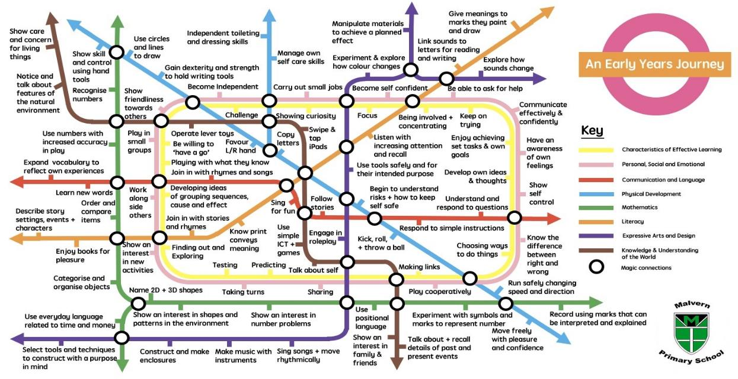
Life at Malvern…
Notes:
Our Day is split into two sessions where children can explore both indoor and outdoors. Our caring, professional team provide exciting activities that foster children’s independence, resilience, self-esteem, self-belief and self- confidence. Our planning provides a range of experiences for children to accelerate within the prime areas. The prime areas are important because they lay the foundations for children’s success in all other areas of learning and of life:
Personal, Social and Emotional Development Physical Development Communication and Language
Our rigorous reading and mathematics programme RWI and Power Maths supports the development of children’s early reading, writing and mathematical skills.

Slide 16
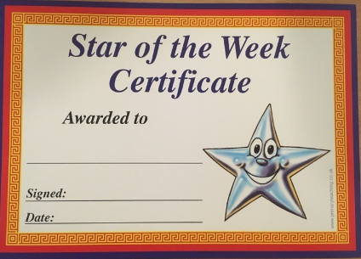
Life at Malvern…
On Friday a child from each class is chosen to be Star of the Week. They take home the class teddy until the following Thursday and can record all the fun they do together. This is awarded to the child who has been just that…. A Star.
Every child in Malvern from R to Y6 belongs to a ‘House’. The children receive House Points for positive behaviour, a good attitude, trying hard and being considerate to name but a few.
The winning house gets a treat at the end of term.

Slide 17
Life at Malvern…
Children can come to school in their own clothes on their birthday.
Children can bring their own water bottles and are encouraged to stay hydrated throughout the day. They will also be offered milk. We provide fruit and snack. We ask for a voluntary contribution of £5.00 each half term.
We go outside in all weathers! Children will need a pair of wellingtons with their name on to keep in school. We would also advise that children bring a warm coat with them each day. Wet suits are provided by the school.

Slide 18
Life at Malvern…
We understand that these are unique times for us all.
We really do value the relationships with all our parents at Malvern and will be as transparent as we can.
Please feel free to ask us any questions.

