Slide 1
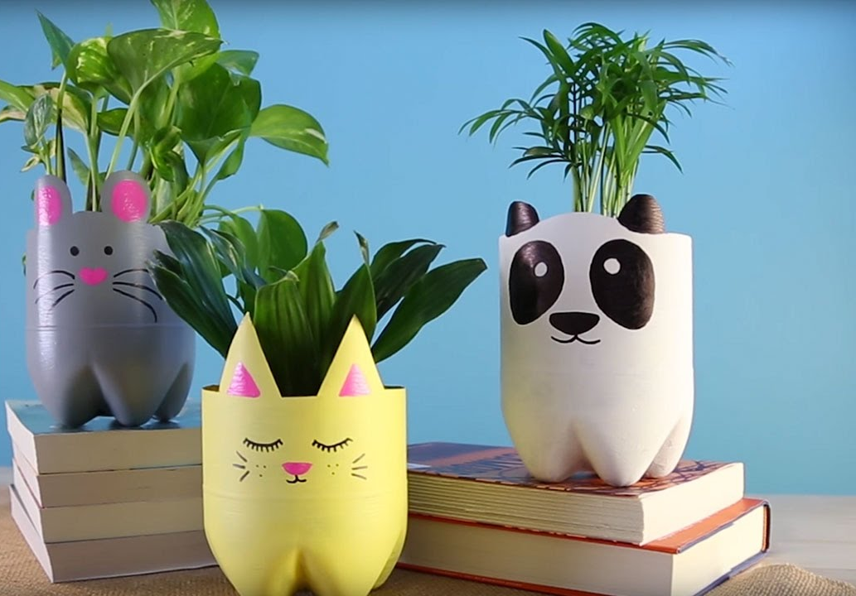
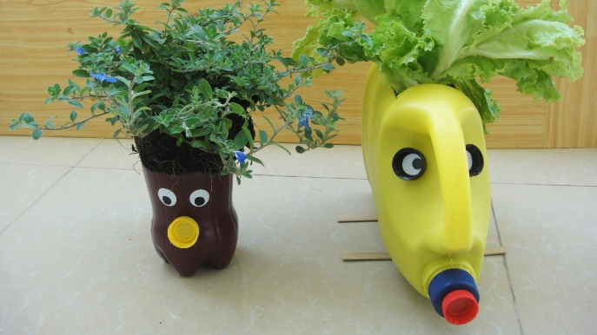
Planter Project
Name
Class
We are going to make planters to recycle things we might usually throw away.

Slide 2
Using the table and information you have researched, list all of the good things about recycling and the bad things.
Good | Bad
In your opinion is recycling good or bad? Justify your answer in the box below.

Slide 3
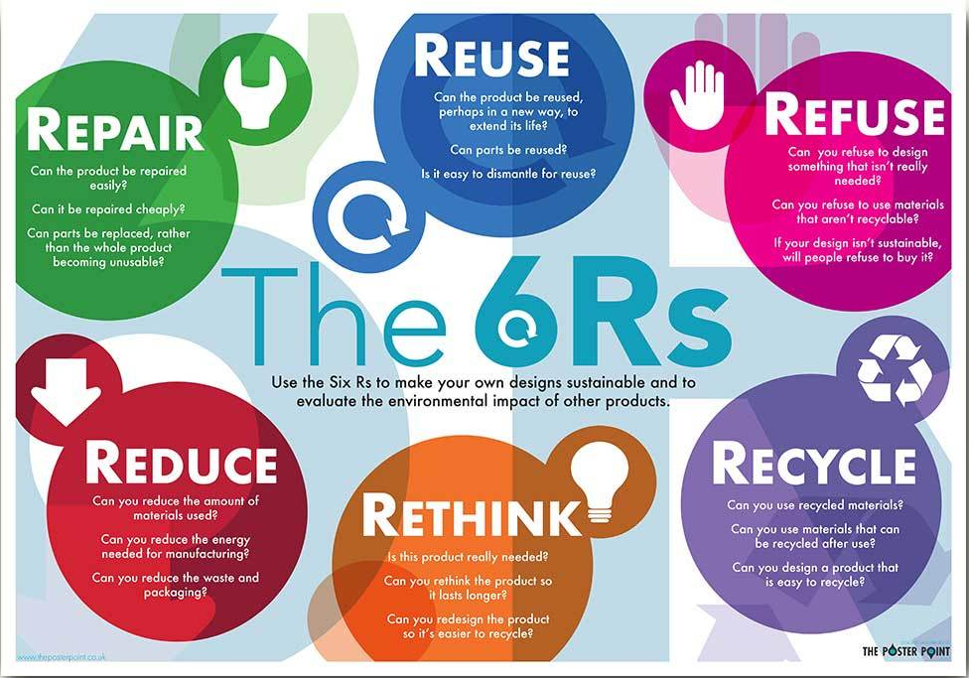

Slide 4
Using the table, consider all of the ways you could apply the 6 R’s to your life. Look at things around your house. I have put my own examples in the table to help you.
The 6 R’s | example | Your answers
Reduce | I probably don’t need to use plastic bags when I go shopping I could reduce the amount I use or buy.
Refuse | I will not buy small plastic water bottles.
Repair | I could sew torn clothes to make them last longer.
Recycle | I should make sure I wash all food packaging.
Re-use | I could repurpose some old products.
rethink | Maybe I don’t need to always drive to the gym. I could walk instead.

Slide 5
Which of the 6 R’s will our planter product help to achieve?
The 6 R’s | How will the planter affect this?
Reduce
Refuse
Repair
Recycle
Re-use
rethink
In the space below create a mind map of the best places to keep your plant pot, think about access to light and ability to water.
Kitchen window
Places for plant

Slide 6
Ideas/designs
Design your planter. Also add labels that explain your ideas more clearly. You may have more than one idea to begin with.

Slide 7
Draw your final design.
List the materials you have and what you are going to use them for.
Recycling items | What I will use them for

Slide 8
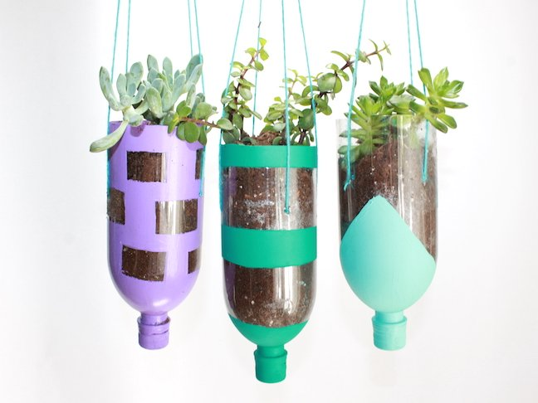
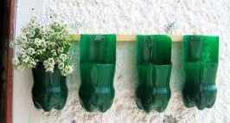
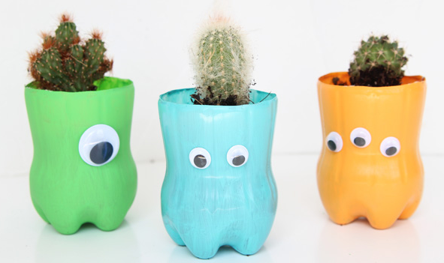
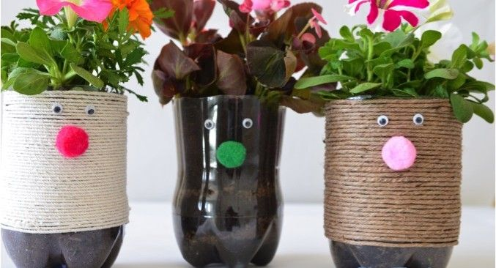
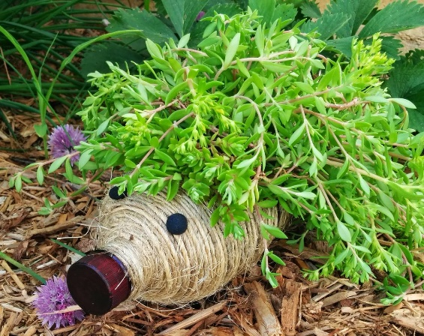
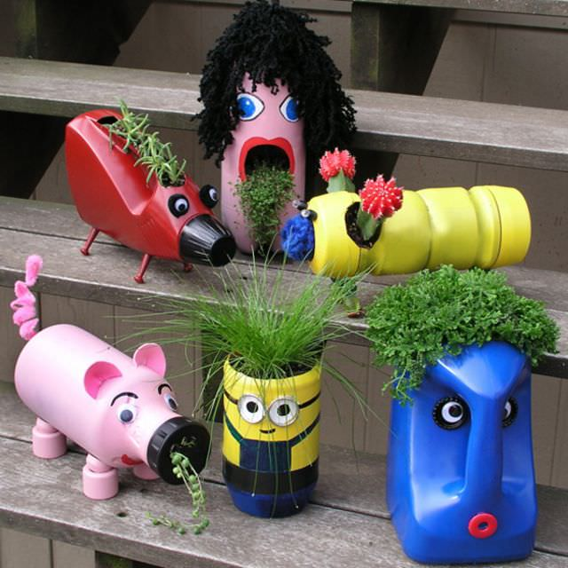
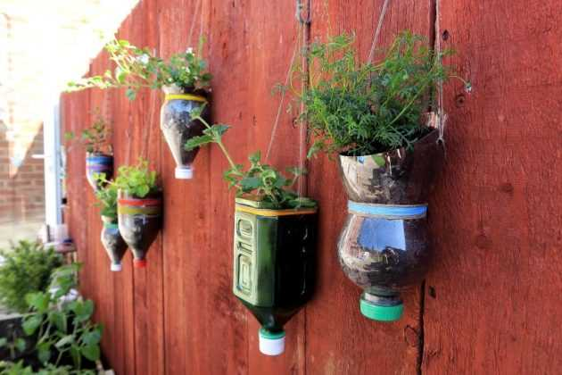
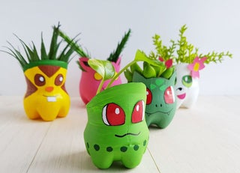
Time to make it

Slide 9
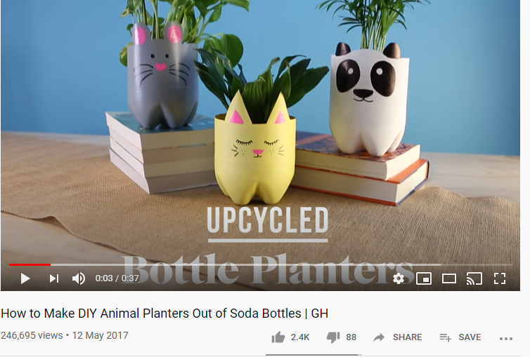
There are lots of YouTube tutorials you can follow depending on your design.
https://www.youtube.com/watch?v=IOb0R7tObD0

Slide 10
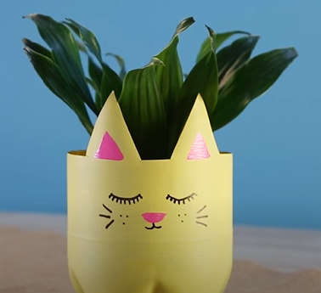
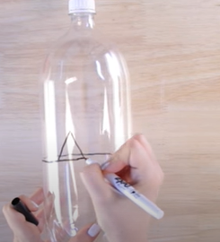
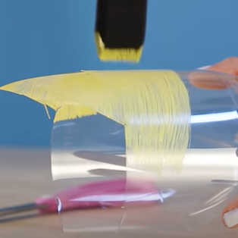
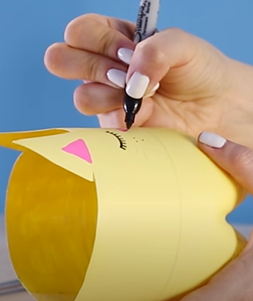
Take picture of your progress and your finished product!

Slide 11
Evaluate your product
Cost
Function
Quality
User friendly?
Environmental friendly?
What would you keep the same if you where to do this project again?
What would you do differently if you where to do this project again?

